Slide 1


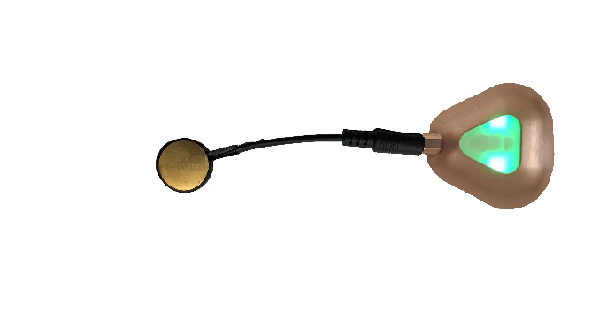
Acoustic MyoGraphy – CURO System and ESTiTM Score

Slide 2
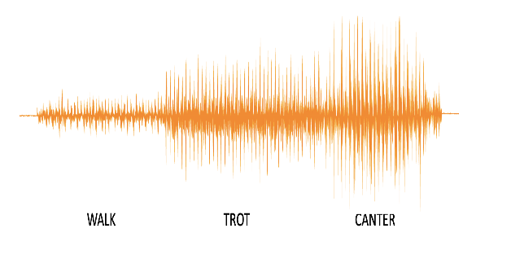
Any given muscle contraction generates an acoustic myography (AMG) signal that comprises three components, a signal amplitude referred to as Spatial Summation, a signal frequency referred to as Temporal Summation, and a degree of efficiency.
These components change with an increase in gait.
By analyzing the amplitude (S-score for spatial summation) and the frequency of the AMG signal (T-score for temporal summation), as well as the periods of inactivity between AMG spikes (E-score for relative efficiency of contractions), it is possible to assess three physiological parameters used by the central nervous system to generate force in a muscle.

Slide 3
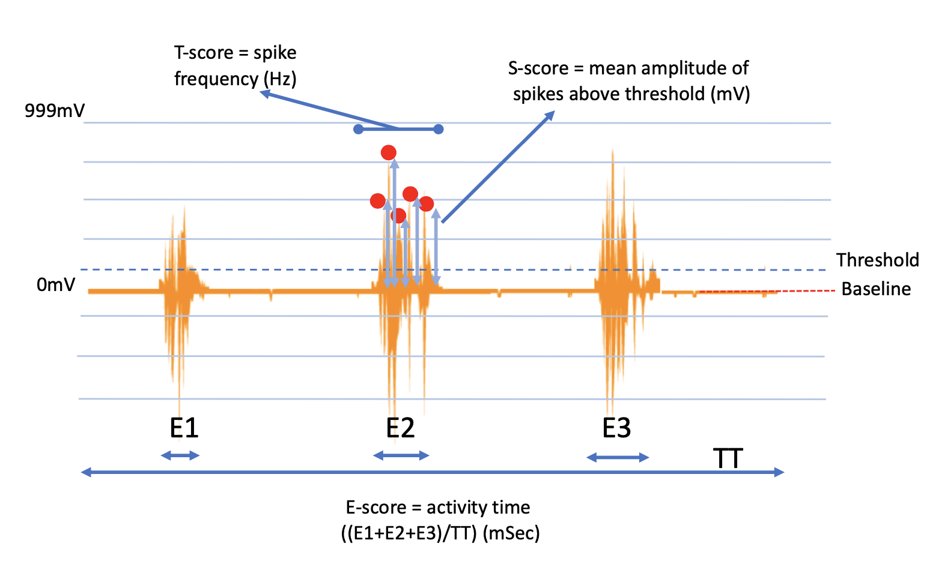
(red • = AMG signals that are above threshold and will be analysed)
Please note that any given AMG signal has an efficiency/coordination (E-score) measured in mSec, an amplitude (S-score; satial summation) measured in mV, and a frequency (T-score; temporal summation) measured in Hz.
In the figure above, TT= total recording time where the sum of E1, E2 and E3 are expressed in relation to TT and represent muscle activity. The red line represents baseline (0 mV). The blue dotted line represents the threshold (typically threshold is set to 7% of the maximum amplitude scale) spikes above threshold are analysed for amplitude and frequency.

Slide 4
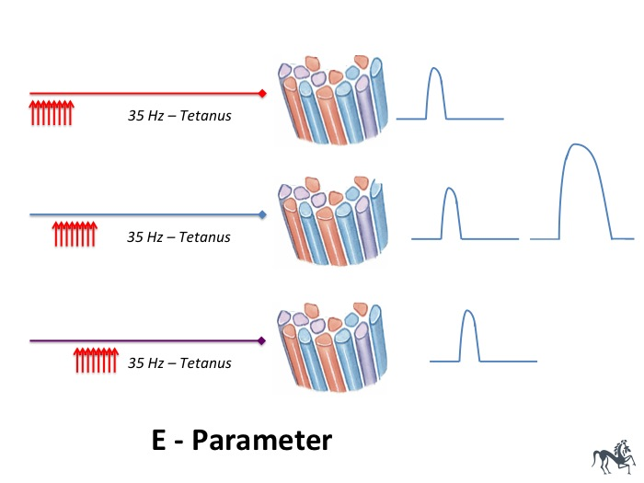
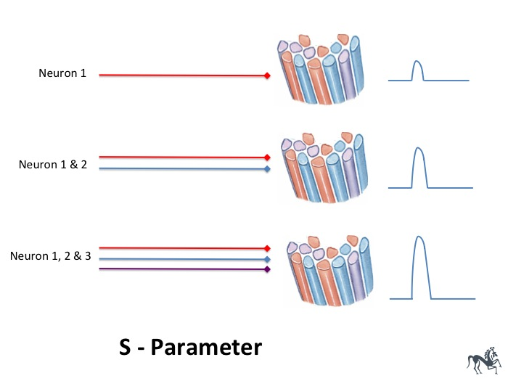
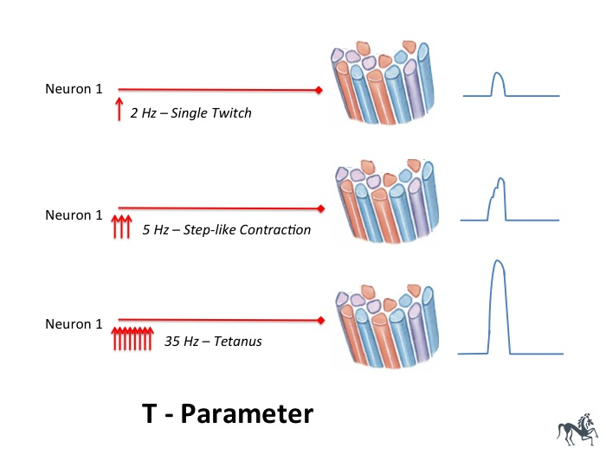
1
2
3
Improved efficiency /
coordination of active motor
units firing together
Increases muscle force
Recruitment of more
motor units increases
muscle force
A more rapid firing
rate of active motor units
increases muscle force
E-score
+
S-score
+
T-score

Slide 5
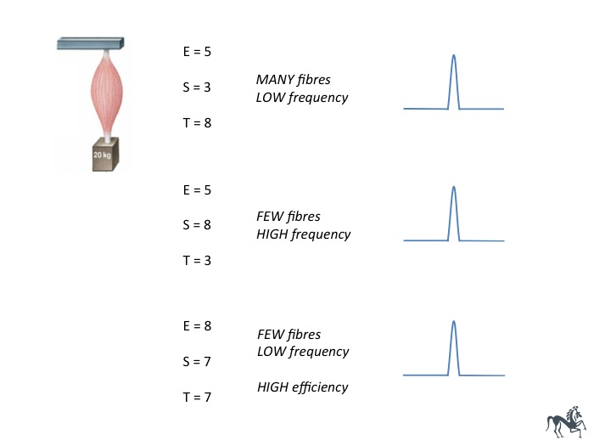
The central nervous system can determine precisely the force generated by a skeletal muscle by determining the number of active muscle fibres (S-score), the rate with which they contract (T-score) and the efficiency /coordination of synchronization (E-score) – all represented by the ESTiTM-score measured using the CURO system.

Slide 6
The AMG score can furthermore be assessed in terms of contralateral muscle contractions at any given gait. By summing the E-, S- and T-scores on one side of a horse and subtracting the scores for the opposite side, a balance score can be created. This serves to not only define which side of the horses´s body is contracting the most, it can also provide information as to whether the number of fibers and their firing rate are more or less equal.
[(E-left+S-left+T-left)-(E-right+S-right+T-right) = Balance score]
[(4.7 + 5.6 + 7.3)-(5.6 + 6.3 + 7.5) = -1.8 Balance score = left side working slightly more]
[(4.9 + 6.6 + 7.8)-(3.2 + 4.1 + 5.5) = 6.5 Balance score = right side working considerably more]
[(5.3 + 5.8 + 7.1)-(5.5 + 6.2 + 6.9) = -0.4 Balance score = both sides working relatively evenly]

Slide 7
Left
Optimum
Right
Fact point:
A high E, S and T-score for any muscle at any given gait represents a highly coordinated contraction from relatively few muscle fibres being stimulated at a relatively low frequency.
If the E, S and T-scores for the left and right sides of a horse are presented as a radar plot, it clearly becomes evident which parameter (s) is (are) imbalanced, making training decisions informed.

Slide 8
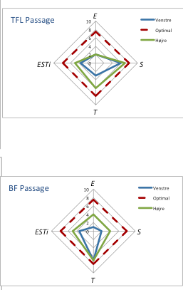
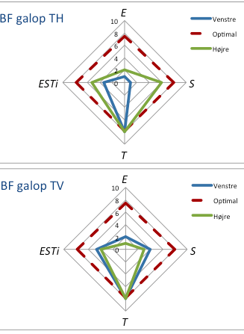
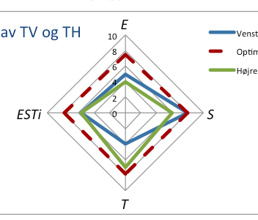
m.Biceps femoris – canter: Top – right hand circle, Bottom – left hand circle:
Note: poor coordination for both right and left hand circles (low E-score), low firing frequency (high T-score) –improved S-score for the right hand circle
m.Longissimus lumborum – trot: Note: good coordination for both right and left sides of the back (average E-score) - Left side few active fibers (high S-score) high firing frequency (low T-score) - Right side few active fibers and low firing frequency (high T-score)
m.Tensor fasciae latae – Top m. Biceps femoris – Bottom: Trot
Note: the imbalance in firing frequency in TFL (lower T-score left side) but fewer active fibers (higher S-score) for BF on the right side
Left versus Right
Muscles

Slide 9
Fact points:
E-score imbalance – training to improve coordination (slow pole work etc) improves this.
S-score imbalance – most likely due to a muscle related injury, train up and strengthen the affected muscle group.
T-score imbalance – often related to pain, or a nerve injury, this improves with administration of a locally applied anaelgesic injection, massage or myofascial release therapy.
In cases of compensation, check that the ST-Score (mean of the S- and T-Scores) isn´t more or less equal – weak spatial summation (signal amplitude) can be compensated for by increased temporal summation (signal frequency) in a muscle, and vice versa. This is because the motor cortex can increase force in any given muscle by either recruiting more muscle fibers (spatial summation) or by increasing the firing rate of active muscle fibers (temporal summation), or both.

Slide 10

“A CURO means you CARE”
Contact: RSD Media Group at 352-456-8338 RSD@myographytech.com
Or
Kristen Beran at 352-222-8256
KB@myographytech.com

