Slide 1
CURO Mk II Equine App
October 2021
New App Update

Slide 2
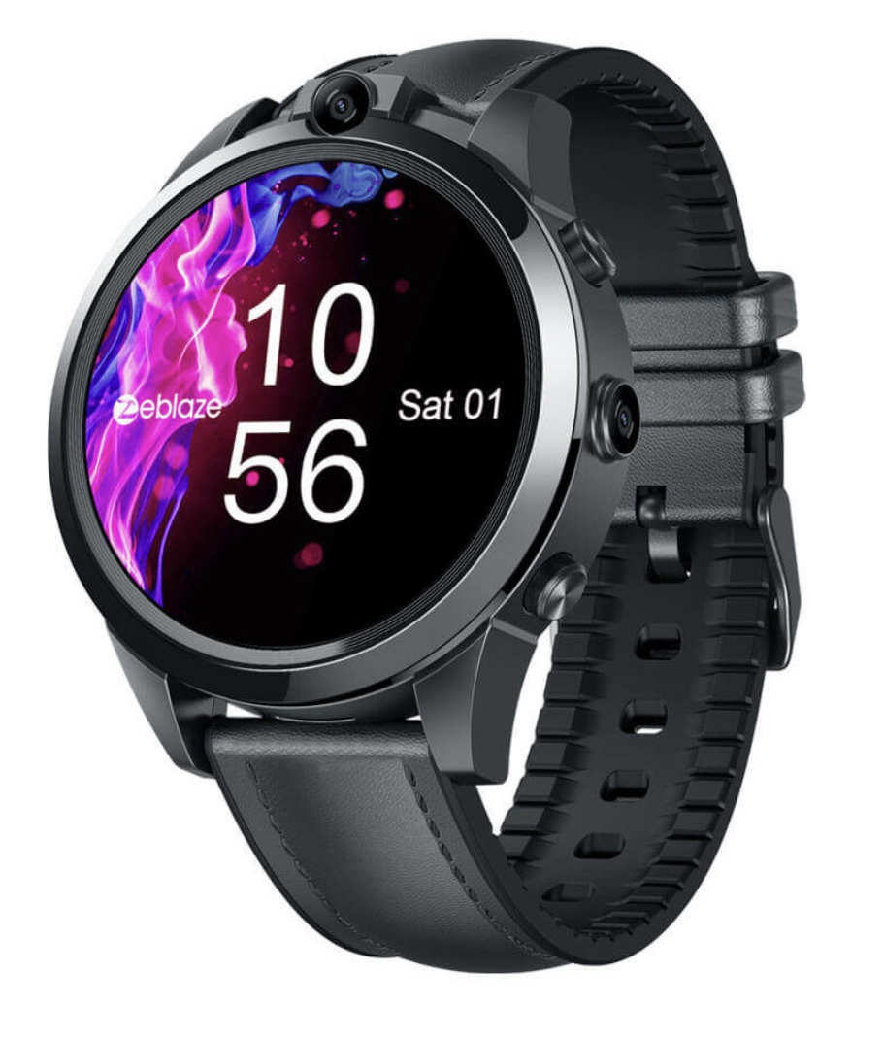
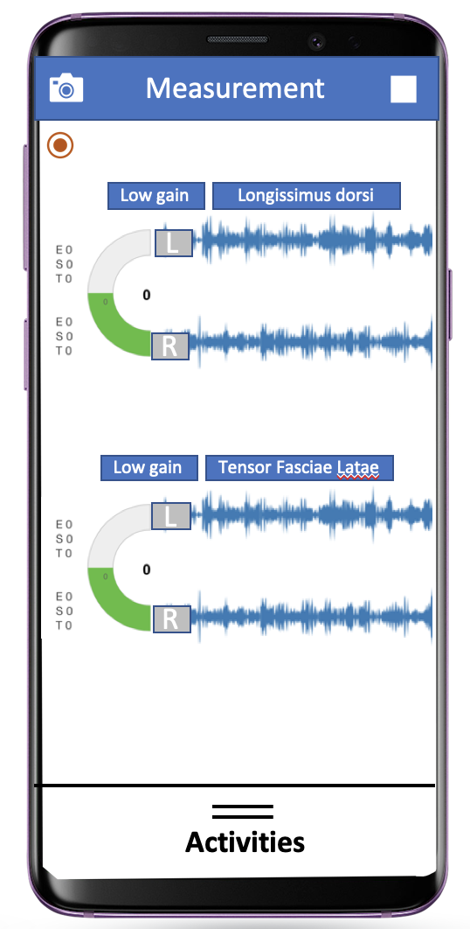
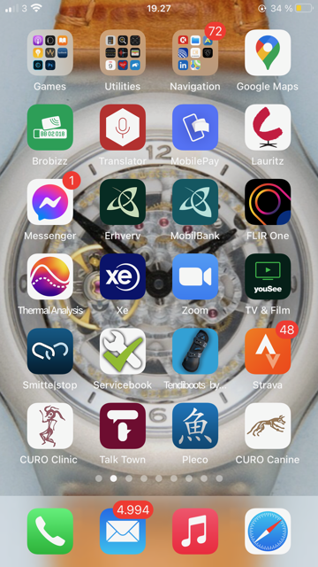
By using a smart watch with a dedicated App on the horse, dog or rider/athlete we can make our CURO system wireless ..
The App´s work on smart phones too, so you can use your own phone for measurements if you so wish ..

Slide 3
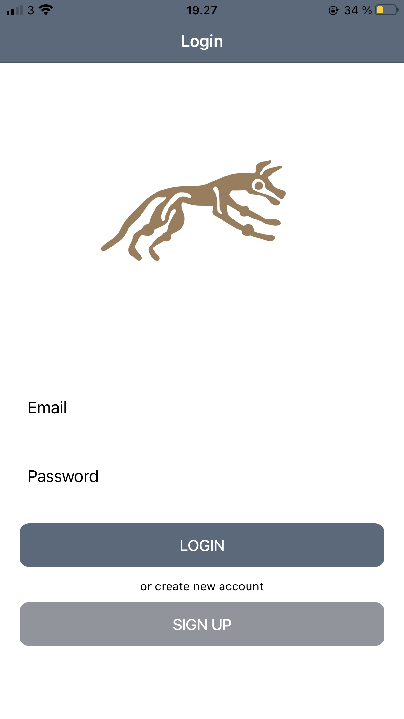
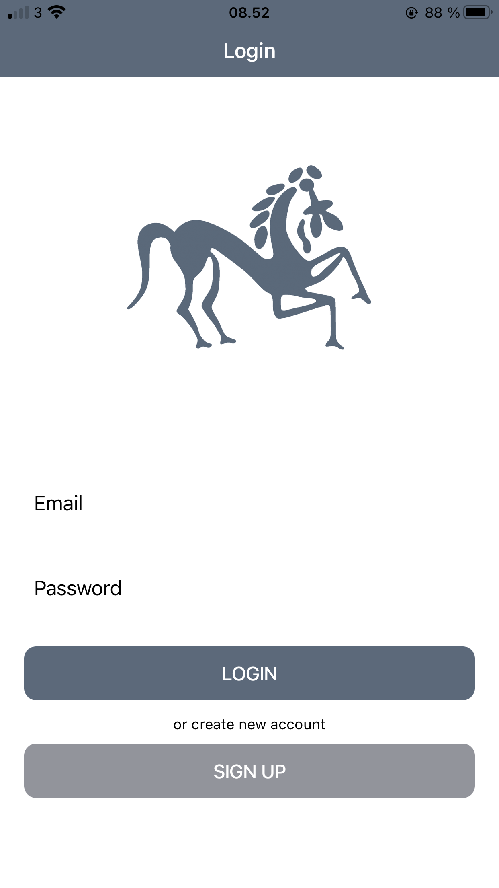
First select you App. There is one for Horses, one for Dogs and a Human (clinical) App to choose from ..
Simply enter your user e-mail and password to get started ..

Slide 4
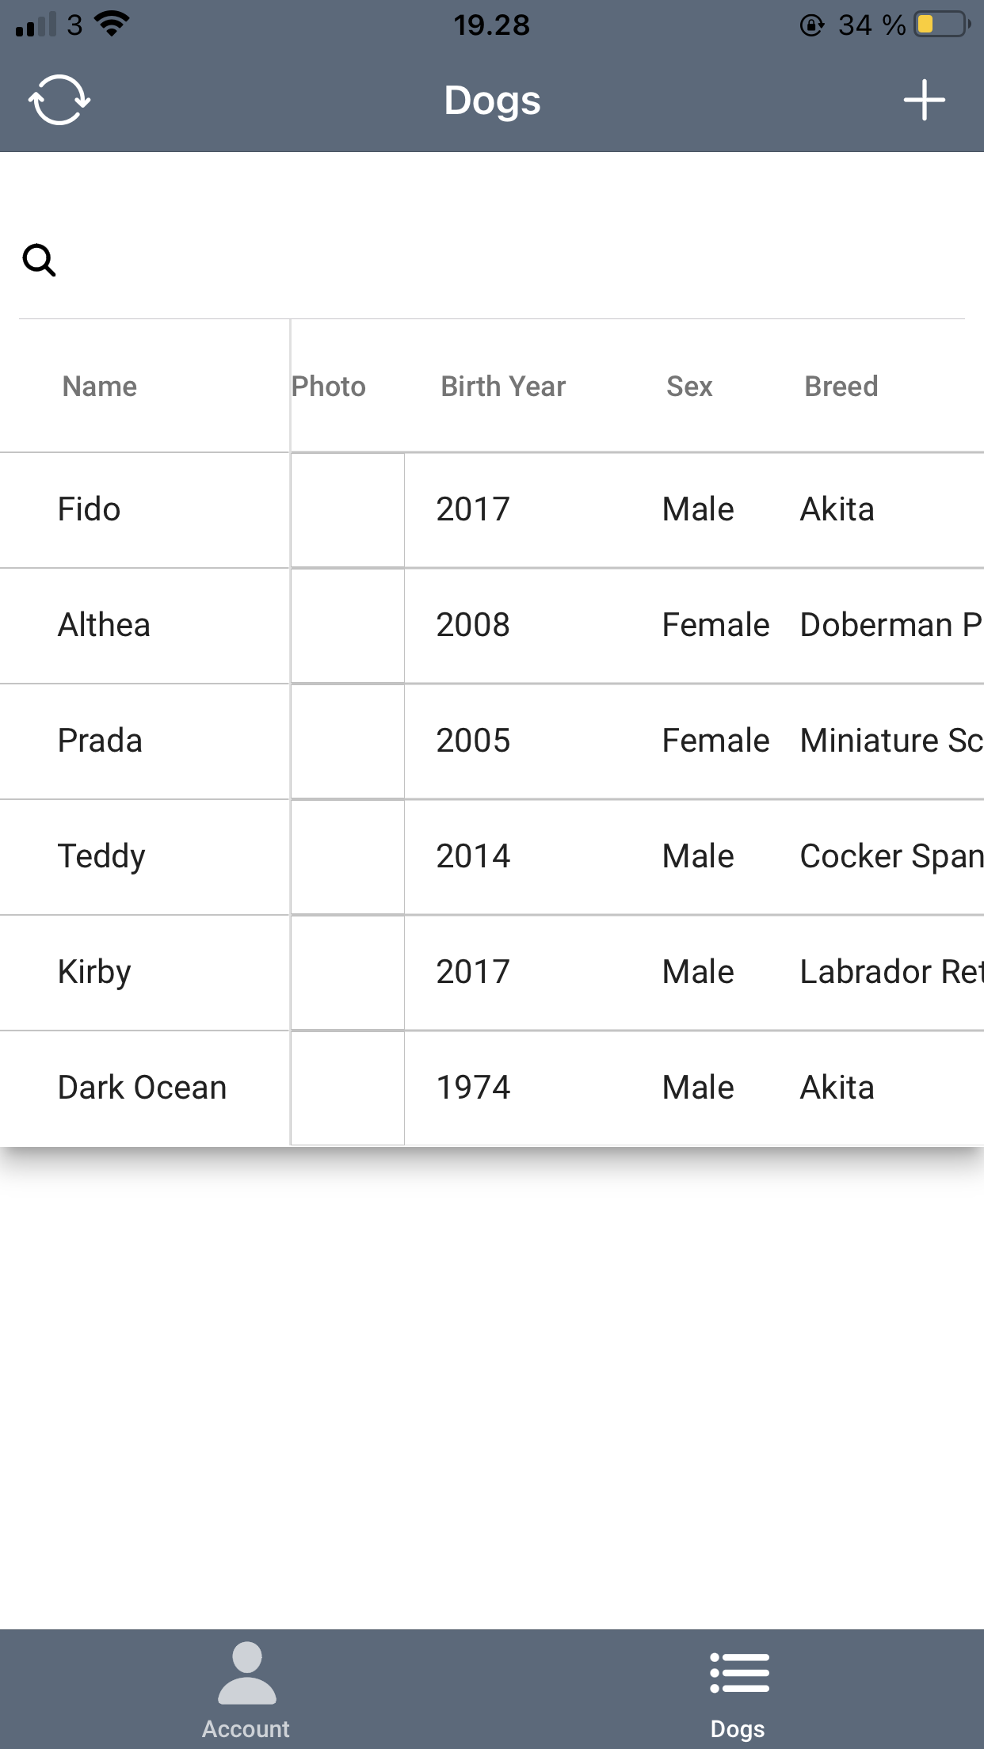
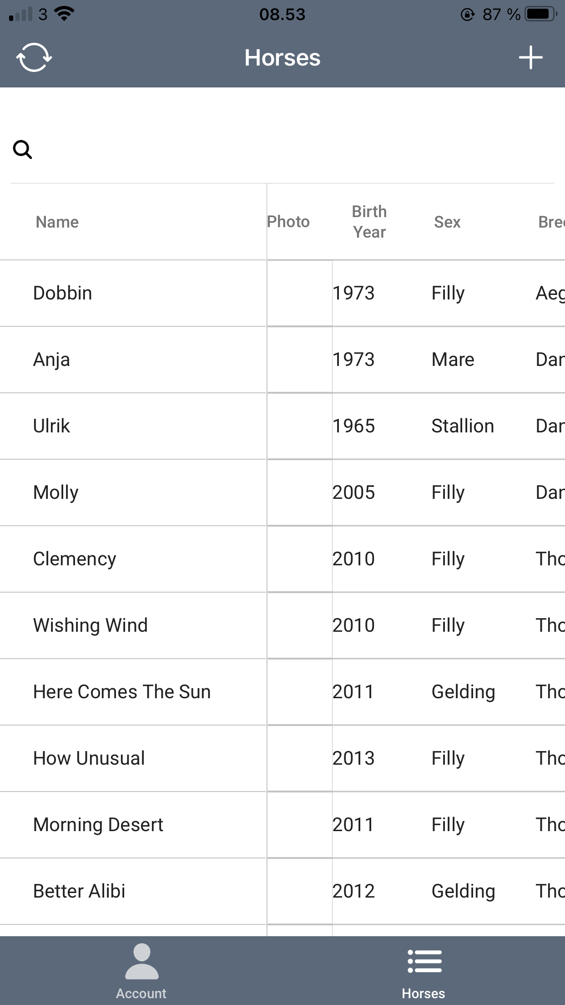
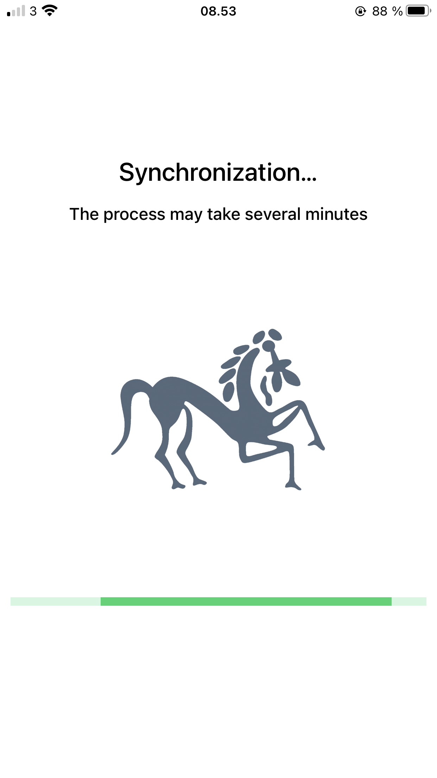
The App opens with a list of the subjects you have measured .. this makes it easy for you to perform repeat measurements over weeks and months and to compare results ..
The subject details are recorded alongside a photo of the subject if you prefer ..
Login is followed by synchronization of all your data, running software plus any company updates ..

Slide 5
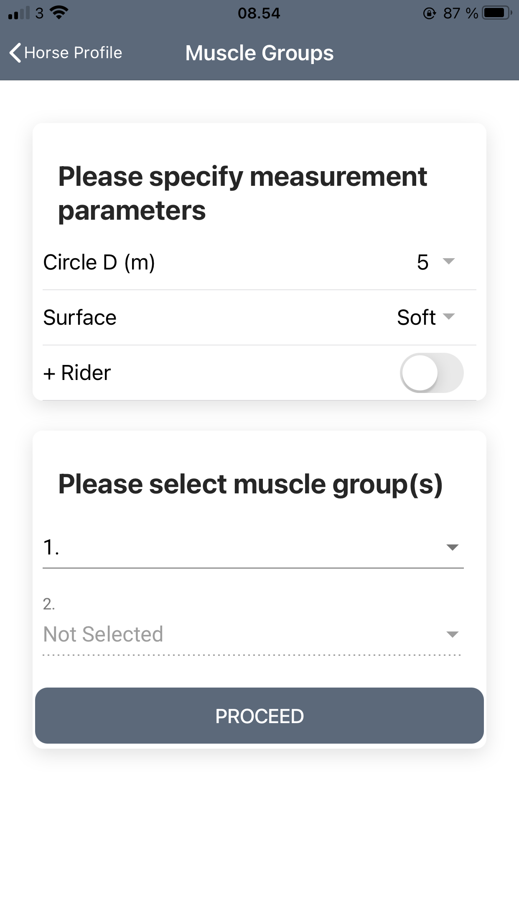
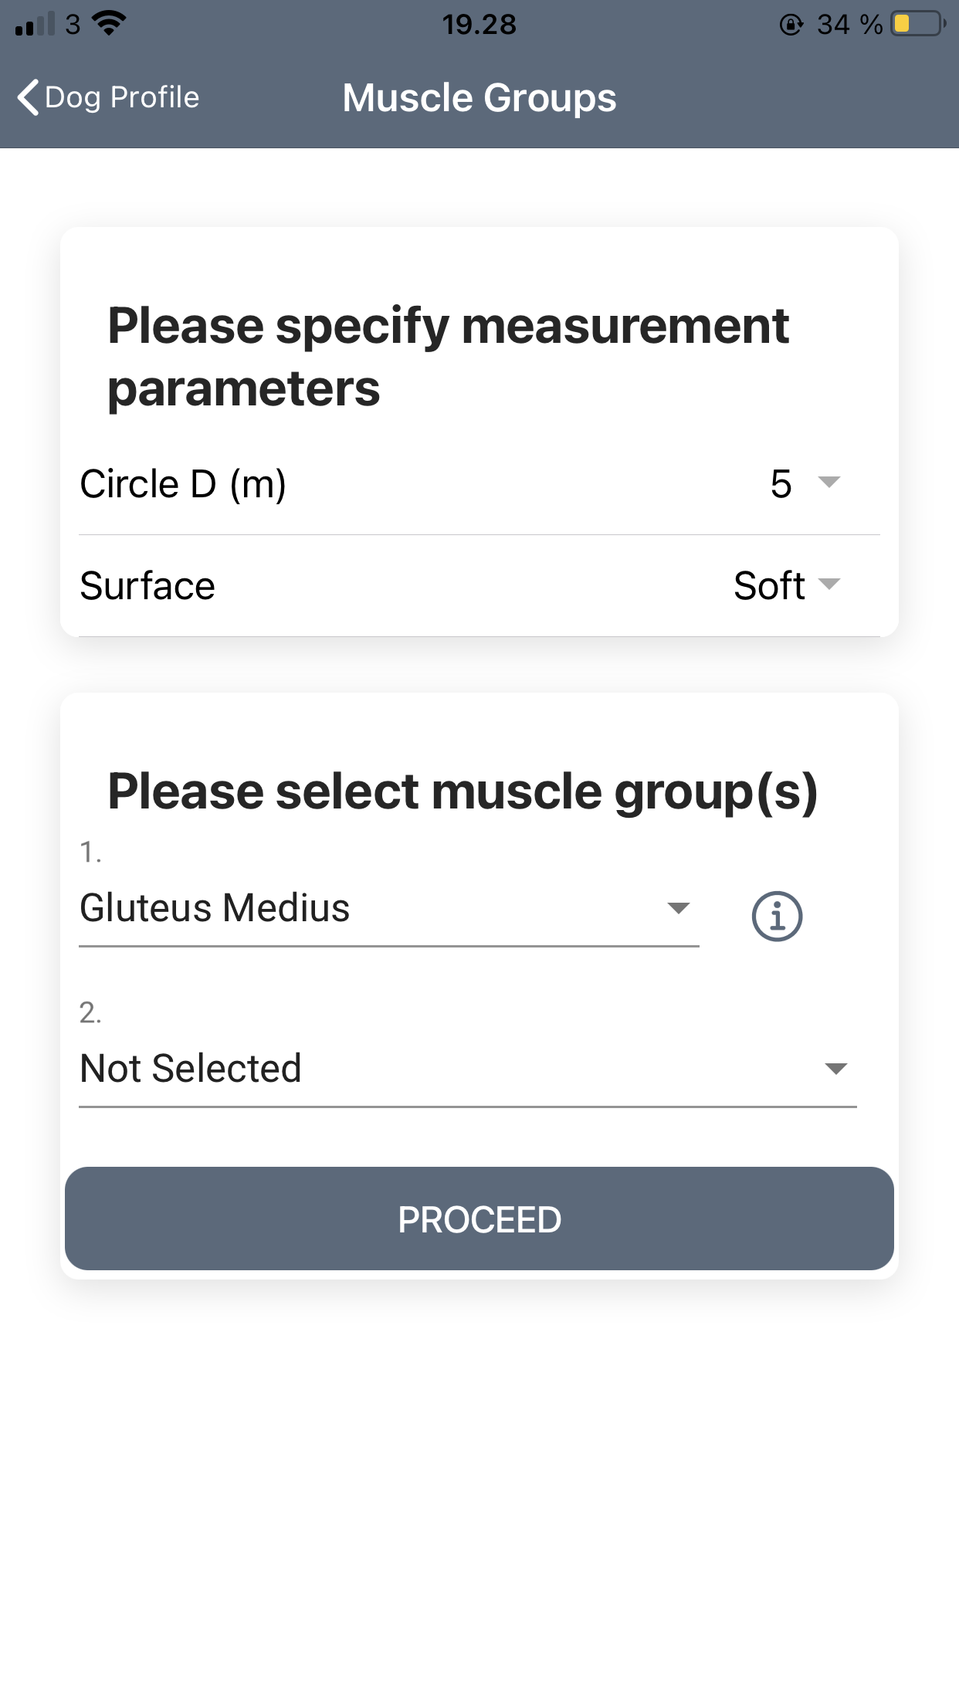
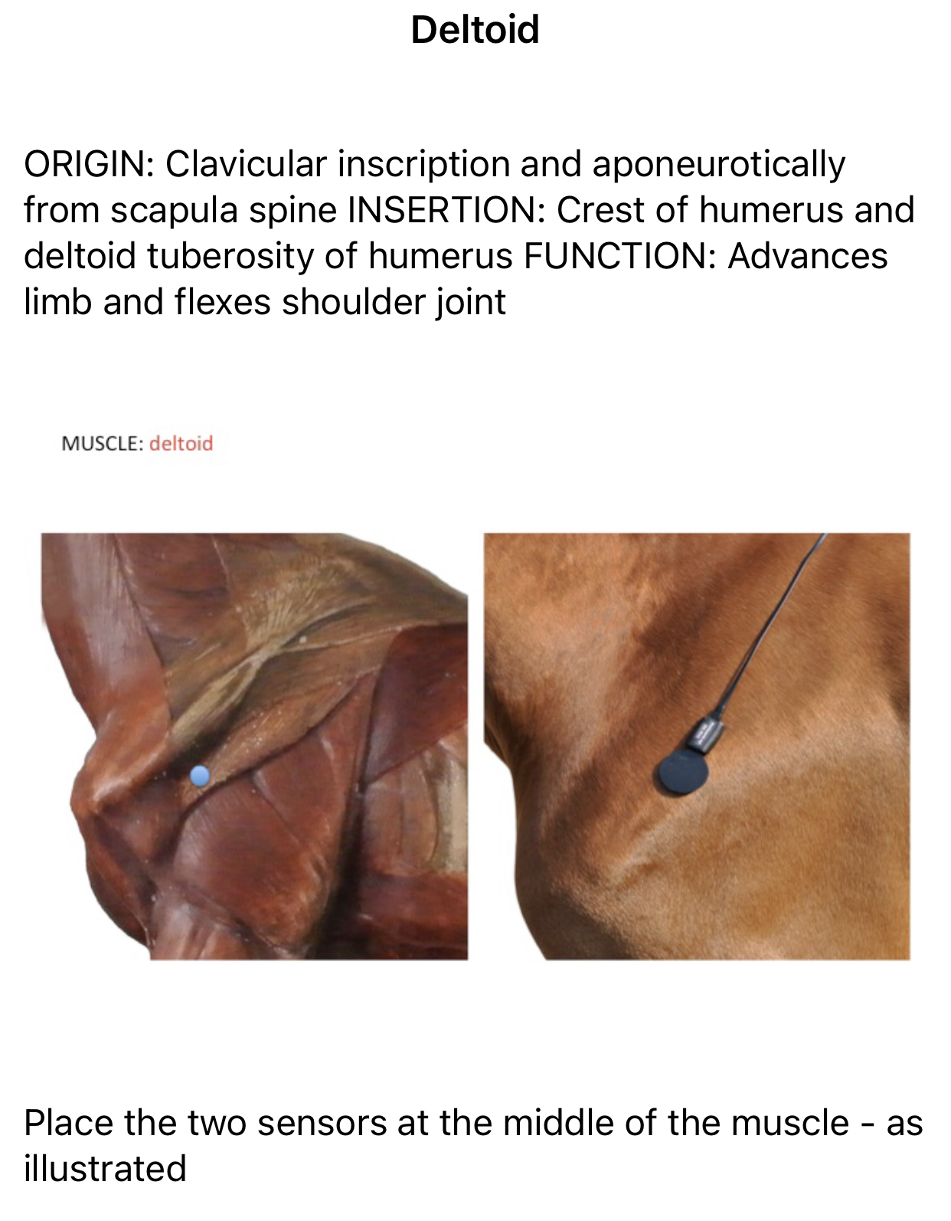
Having selected a subject, you can then select a muscle group to measure from .. as well as decide on the circle size for exercise training and the surface on which training is to take place .. a rider etc … The App also provides anatomical details about the muscle you have selected ..

Slide 6
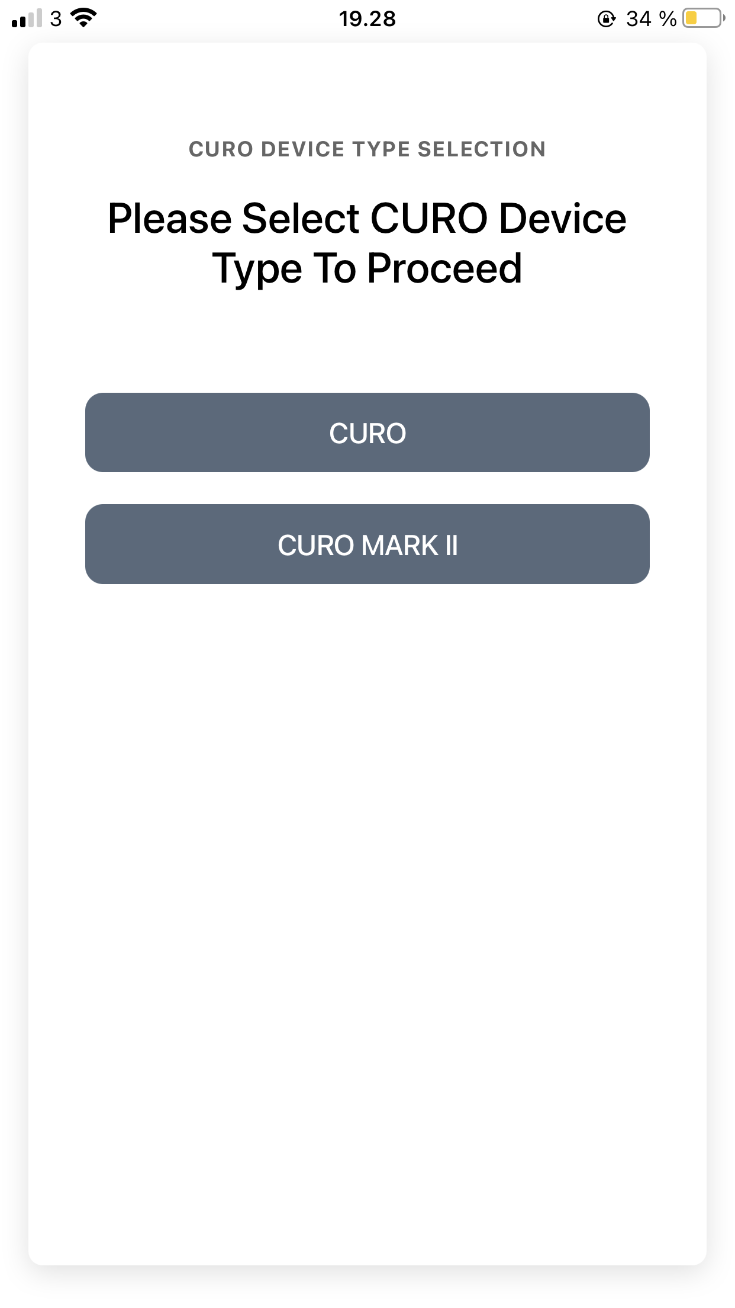
You can select between using our exisiting research CURO units or the new wireless Mk II units .. you choose what suits you best ..

Slide 7
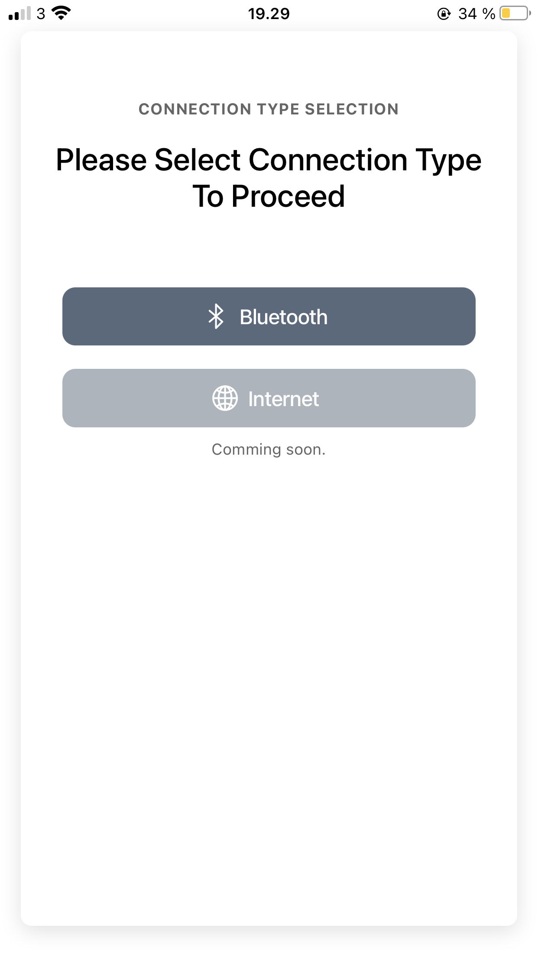
Next select a ”Local” recording (within 40 m of the subject) or a ”Remote” recording that can be almost any distance away from your subject of interest ..
For ”Local” select the Bluetooth button

Slide 8
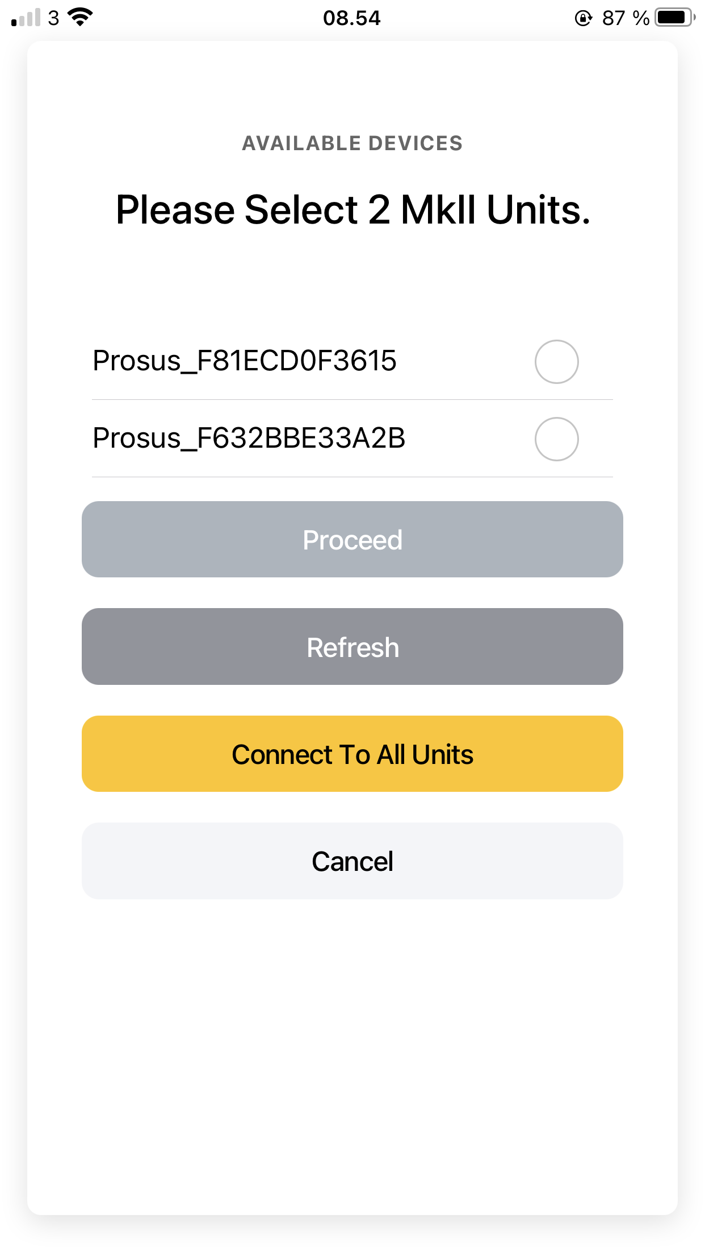
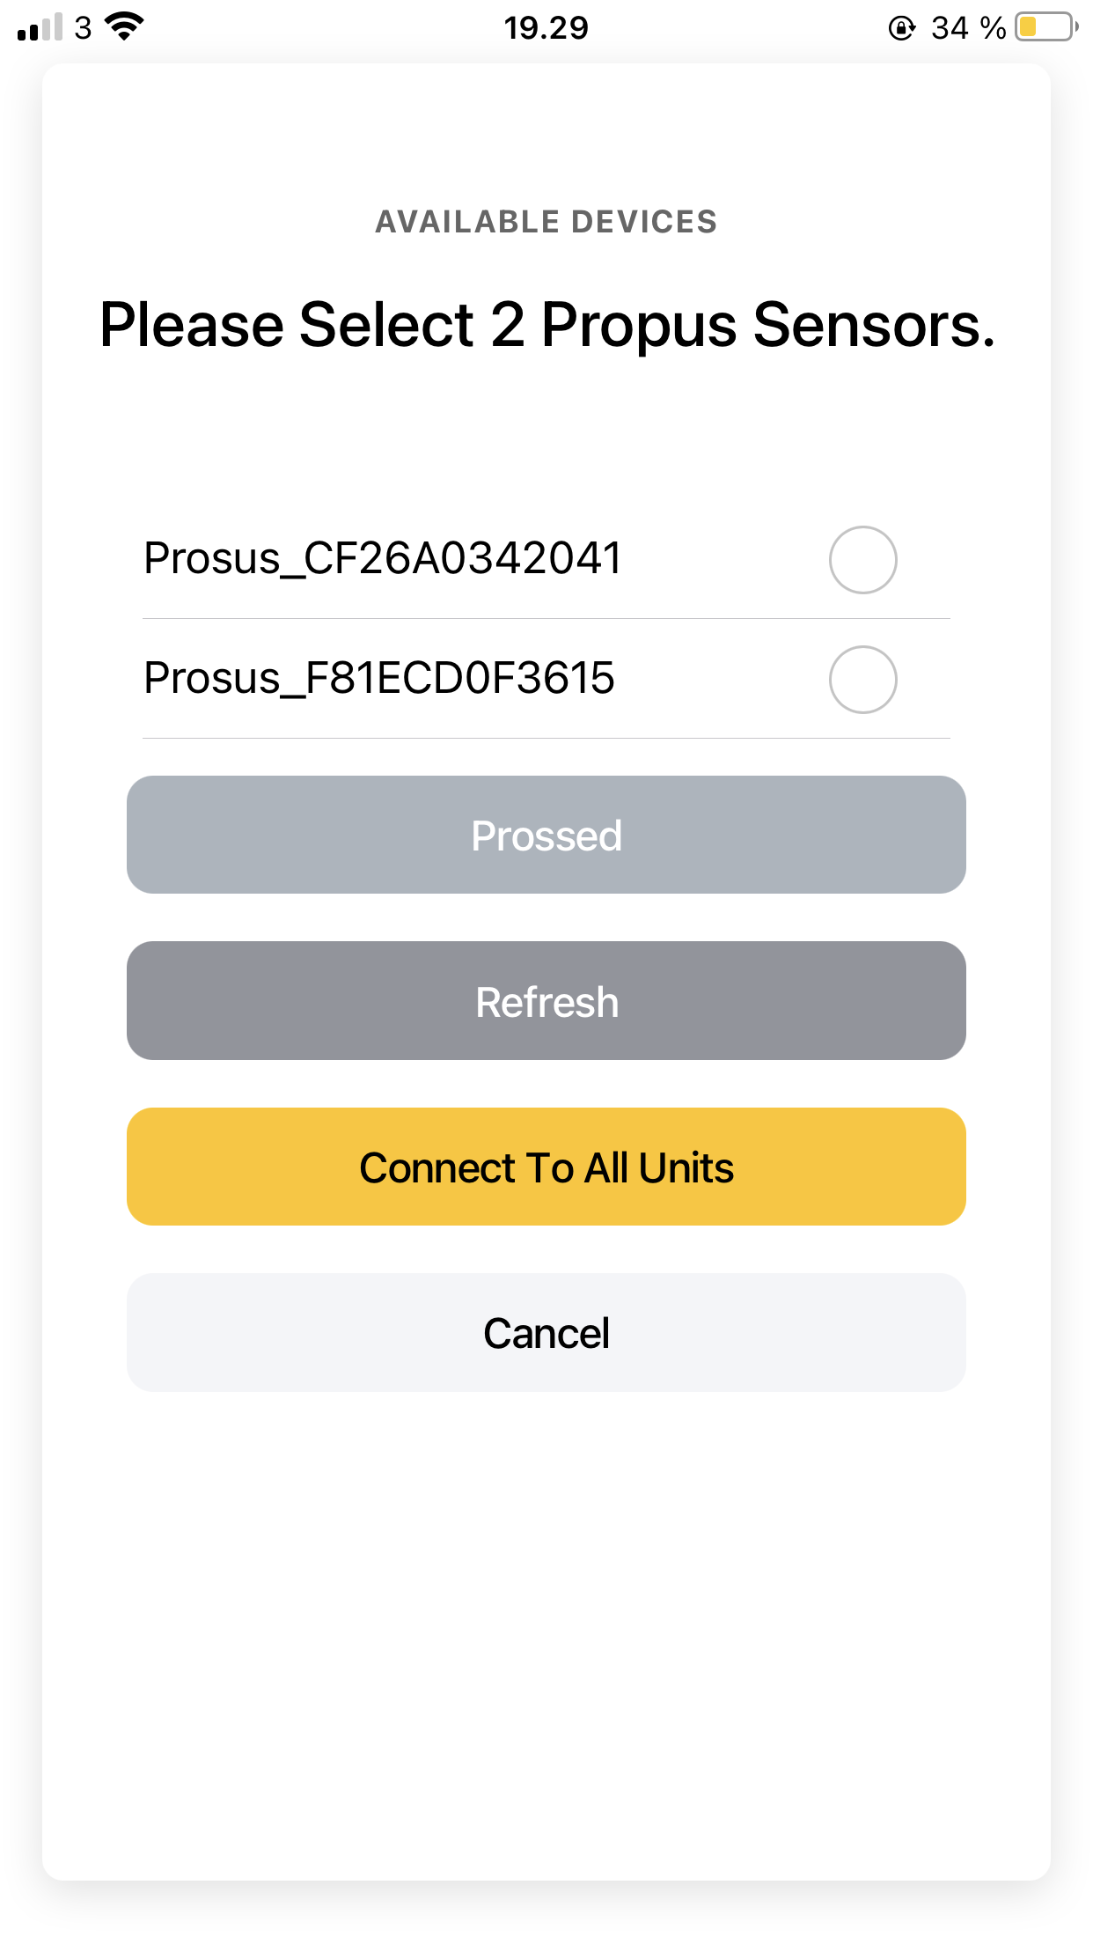
If you choose the new wireless CURO units then they are activated when you connect a sensor .. they will then appear automatically on your smart watch/phone for you to connect and assign to a muscle group ..
Simply toggle the units ”on” as needed and then press ”proceed” to move to the next screen ..
Please Select 2 MkII Units
Processed

Slide 9
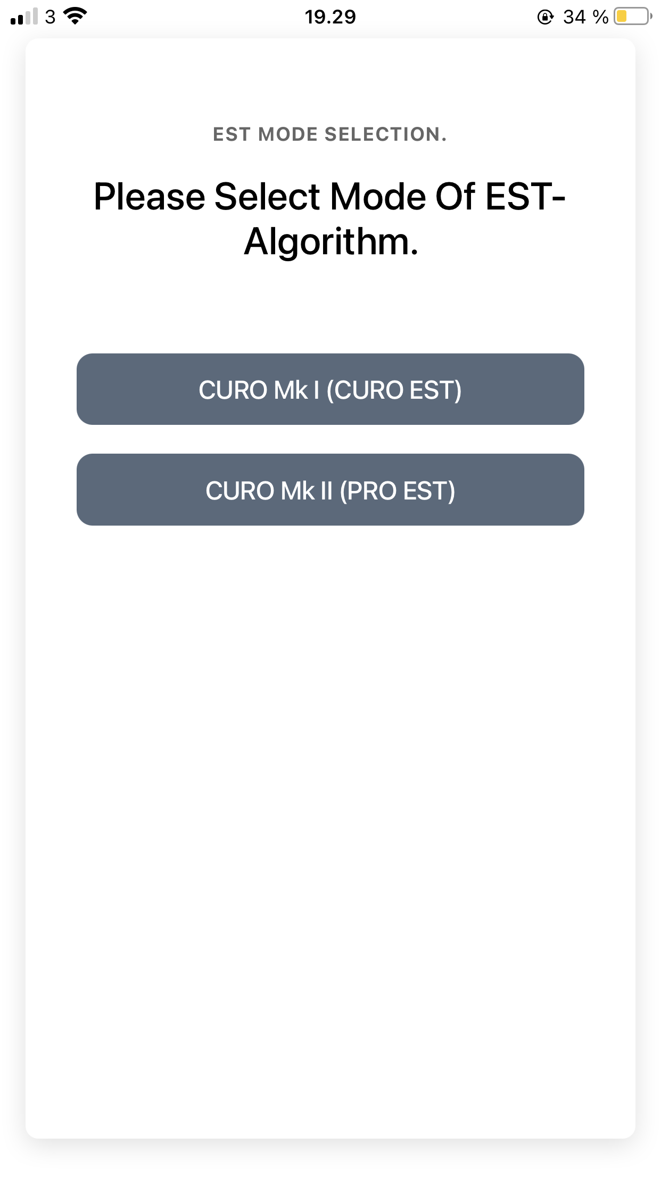
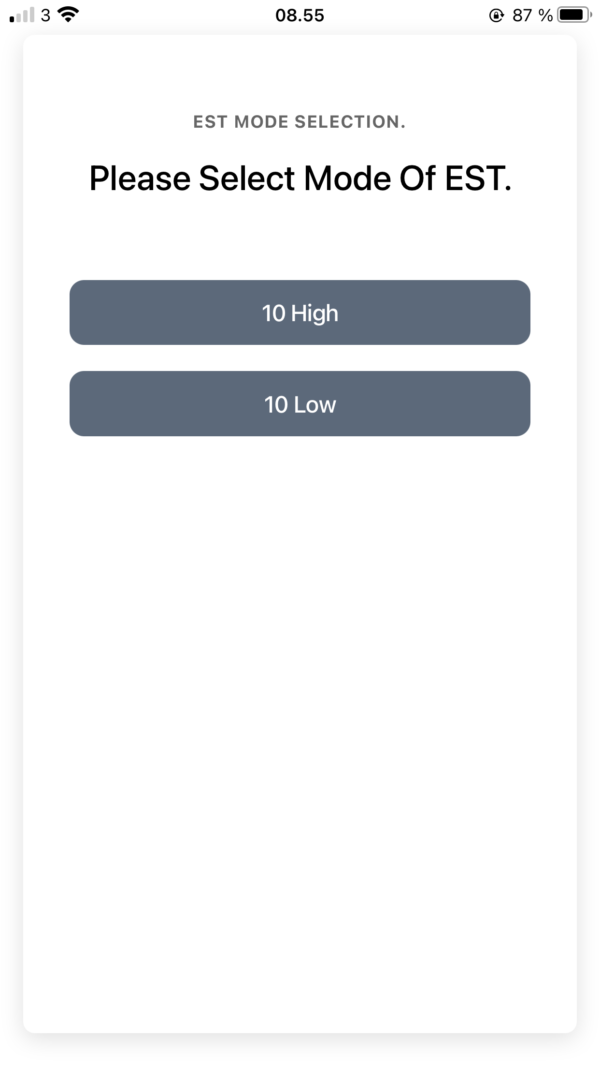
Next select how you wish to analyze the measured data .. Do your prefer your optimal recordings to have a ”High” or a ”Low” number ..
If you feel that a good muscle performance makes more sense when the E-, S- and T-scores are close to 10 then choose 10 High ..
If good muscle performance makes more sense when scores are low then choose 10 Low ..

Slide 10
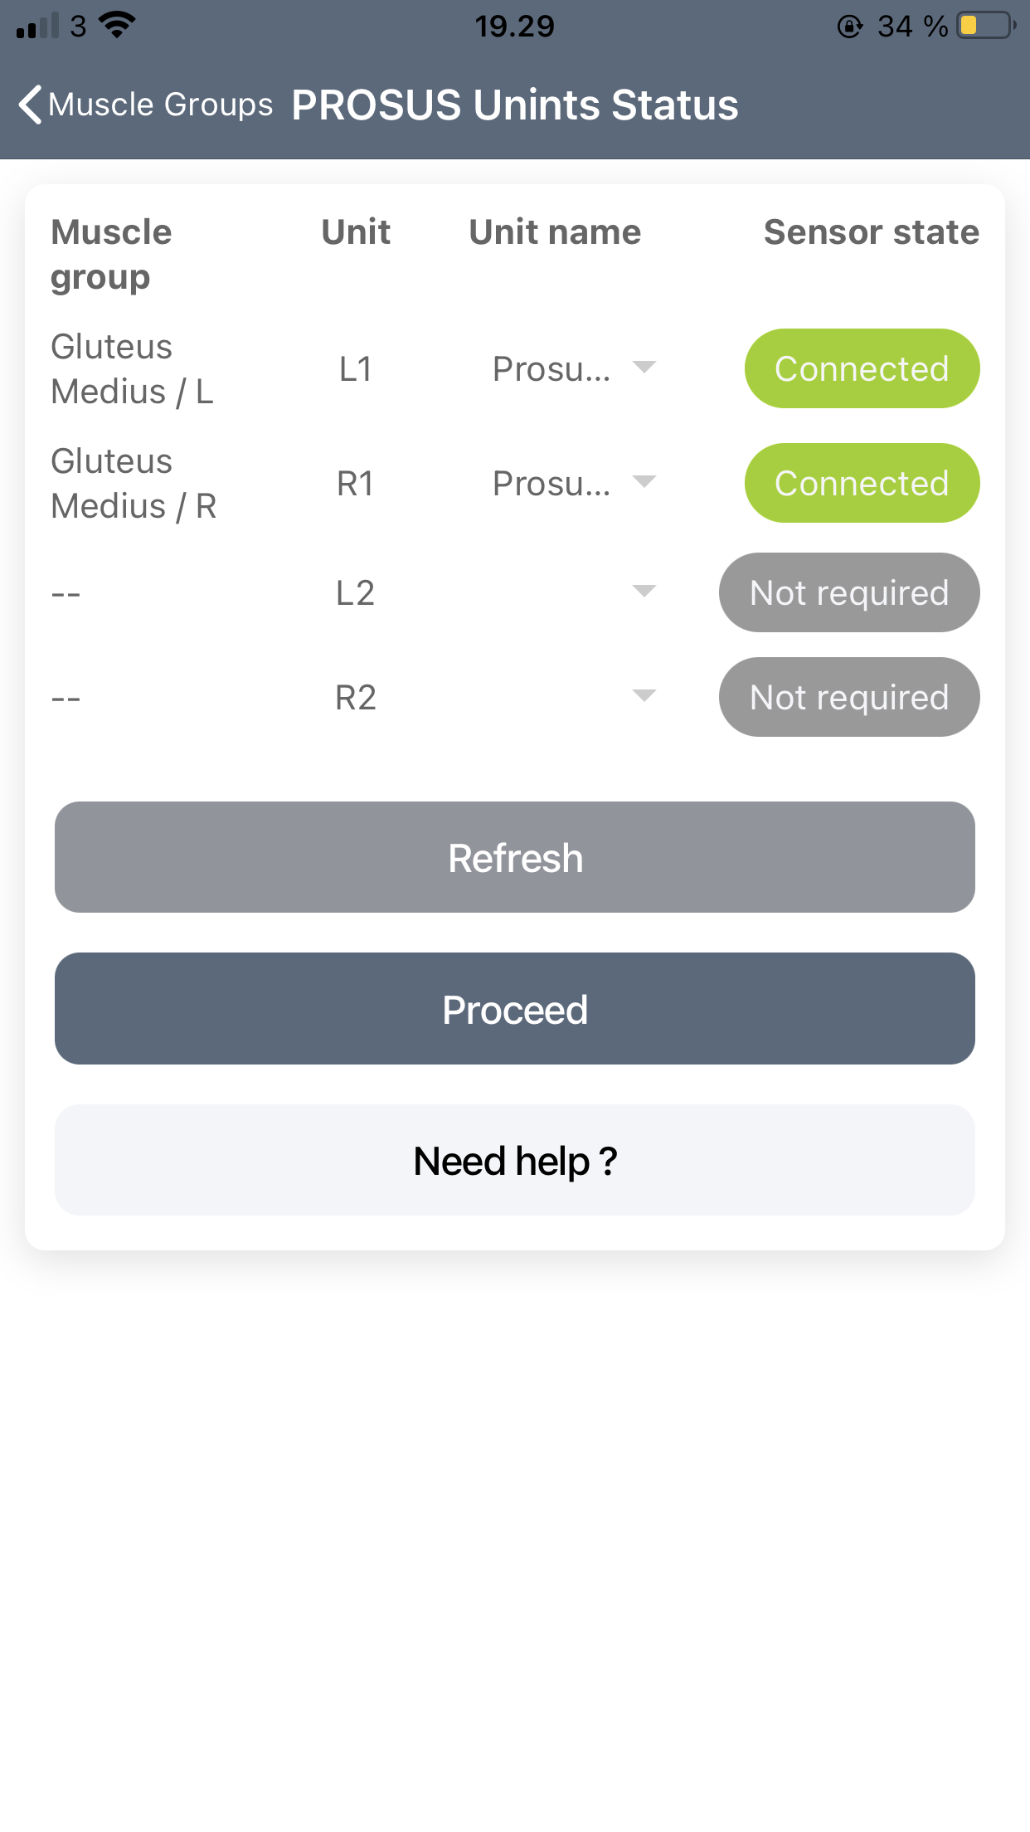
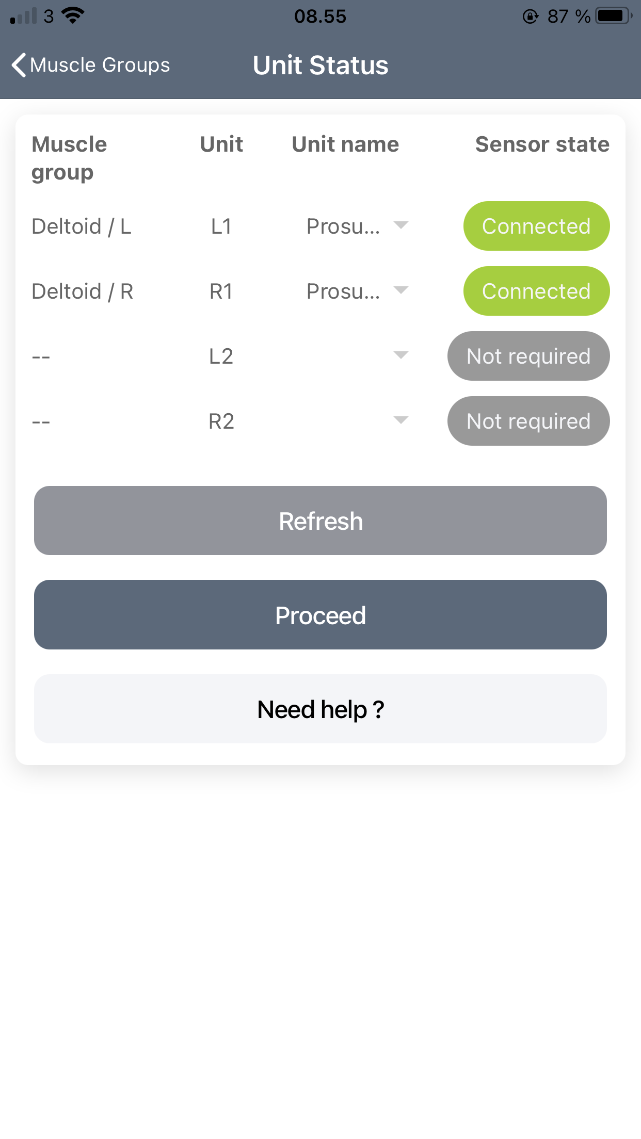
You will now be able to see how many CURO sensors you have coupled up, whether they are measuring the left or right sides of your subject as well as which muscle group they are recording from ..
When you are ready to start a recording press ”Proceed” ..

Slide 11
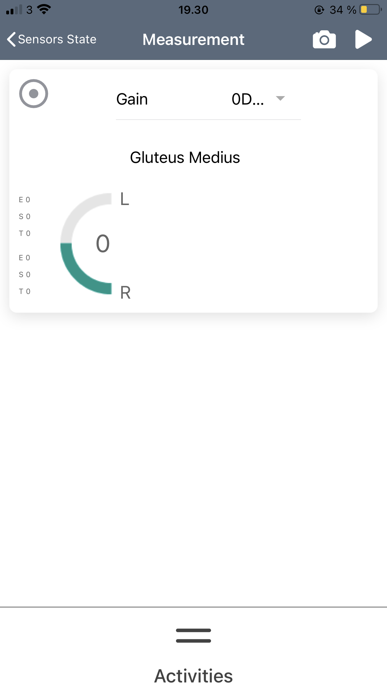
The CURO recording page looks like this ..
You can adjust the sensitivity of the recordings by pressing the ”Gain” button, select activities from the lower panel and even take screen shots by pressing the Camera symbol at the top ..
Start a recording by pressing the triangular arrow ..

Slide 12
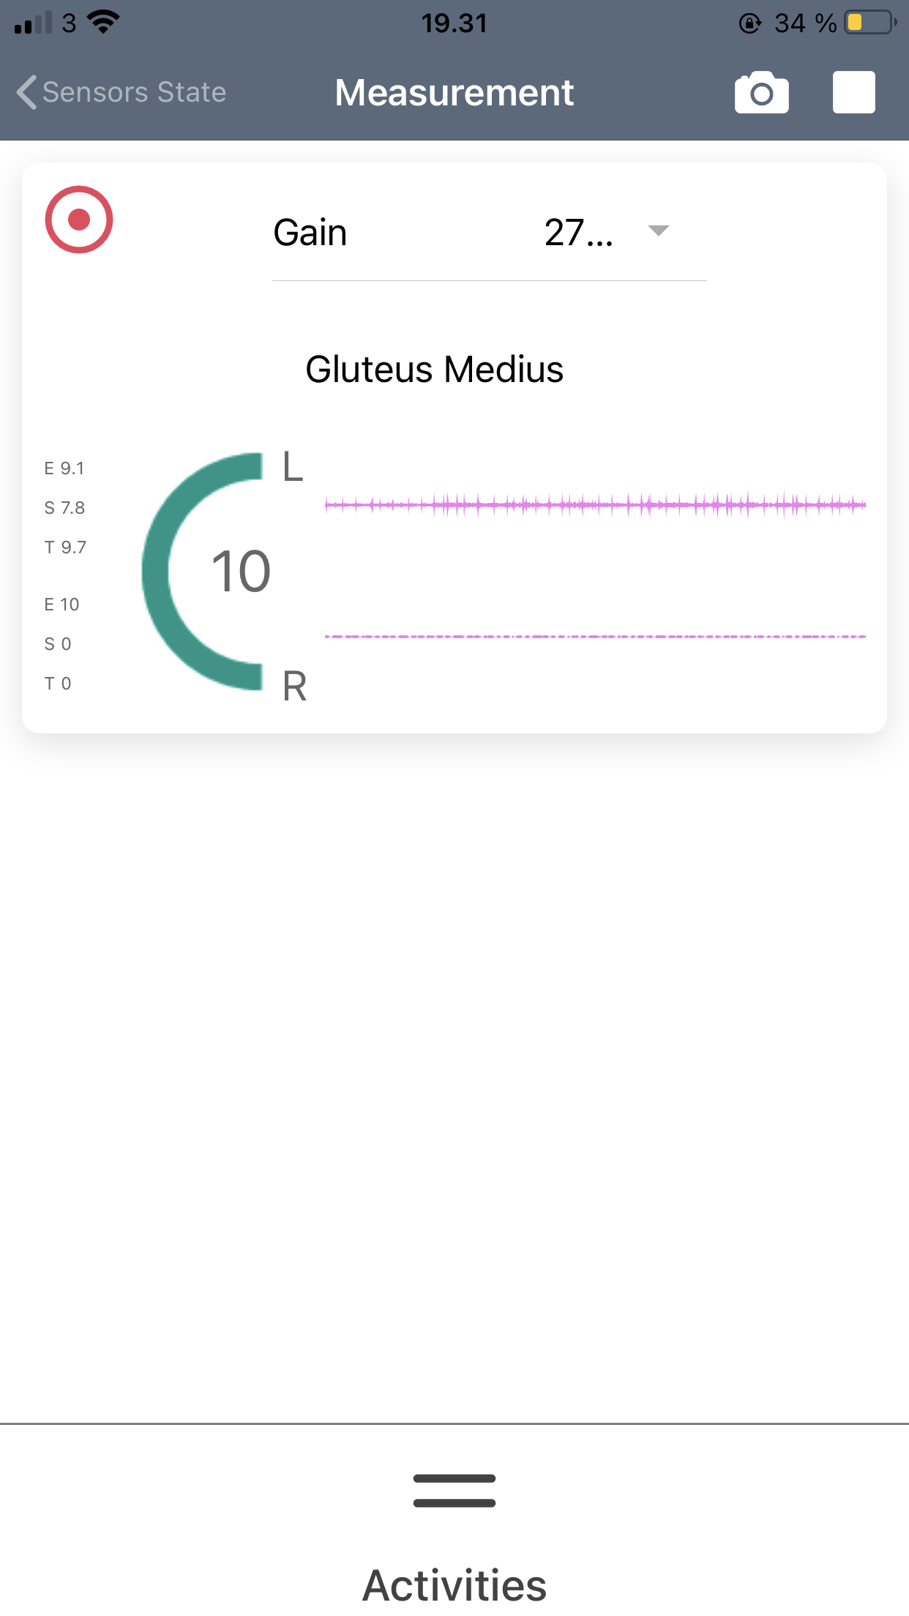
Your recordings will be saved to either the smart watch or smart phone until the App can connect with your Client Cloud and transfer your recorded data to your stored data ..

Slide 13
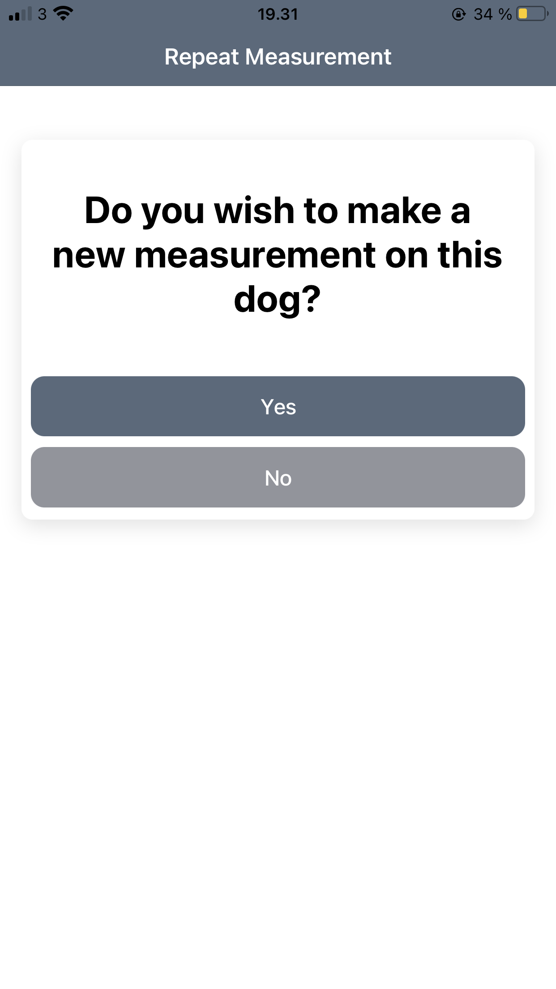
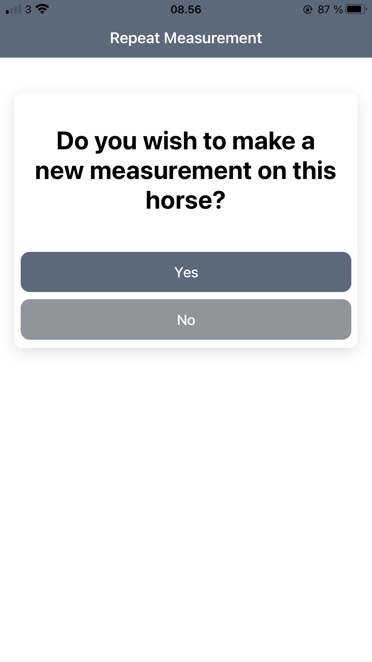
When you are finished you can stop your measurements ..
The final page allows you to stop recordings for a subject altogether, or move your sensors to different muscle groups and make some further recordings ..

Slide 14
Here is a quick video of the App from start to finish ..

Slide 15
Contact: RSD Media Group at 352-456-8338 RSD@myographytech.com
Or
Kristen Beran at 352-222-8256
KB@myographytech.com

